Slide 1
Credit Unions:
A consumers best financial partner
America’s credit unions celebrate 100 million memberships
Pat Wesenberg
Central City Credit Union
Marshfield, Wisconsin
Notes:
Thank you very much for the opportunity to be here.
I am the immediate past Chairman of CUNA the Credit Union National Association in America
I am the CEO of a credit union in the state of Wisconsin, which is in the Midwest in the Great Lakes region.
My credit union is called Central City Credit Union we serve 24,000 members and have $215 million U.S. dollars in assets. We provide a full variety of services and loans for vehicles, recreation, personal use, agriculture, business, homes, credit cards and can meet most of the requests made by our members.
I have worked at my credit union for 33 years and have served on the CUNA board of directors for 12 years.

Slide 2
Credit unions in the United States
100 million memberships
Nearly 6,700 credit unions
Nearly 245,000 full-time employees
CUNA represents credit union interests in Washington, D.C., provides training, services and information
State leagues represent credit unions at state capitals
Notes:
A quick profile of credit unions in the United States reveals:
There are 6,700 credit unions with roughly 245,000 employees spread among these independent, cooperative financial institutions.
We surpassed 100 million memberships this summer
Assets: $1.125 trillion U.S dollar
Loans: $688 billion
Surplus funds: $383 billion
Consumer Savings: $881 billion
Volunteers: 86,000 Americans (serving as board members, committee members or providing other assistance.
Capital to Assets: 10.3%
The largest ATM network in the United States : 30,000

Slide 3
United States credit union finances
Improving following financial crisis
Moderate savings and asset growth
Strengthening loan growth
Loan delinquencies and losses about back to normal
Rising net worth ratios
Notes:
Credit unions came through the financial crisis caused by the big Wall Street banks in good shape. While credit dried up at other institutions, credit unions were able to keep lending to members to enable them to own homes, start a business create jobs. In many small communities that made a critical difference in the quality of life for many.
In many measures, credit unions are beating the banks today because of the conservative approach CUs took during the crisis.
Credit unions are led by Volunteer Boards. Each credit union is governed by a board of directors, elected by and from the credit union's membership. Board members serve voluntarily.
Membership Eligibility. By current federal statute, credit unions cannot serve the general public. People qualify for a credit union membership through their employer, organizational affiliations like churches or social groups, geographical location or a community-chartered credit union.

Slide 4
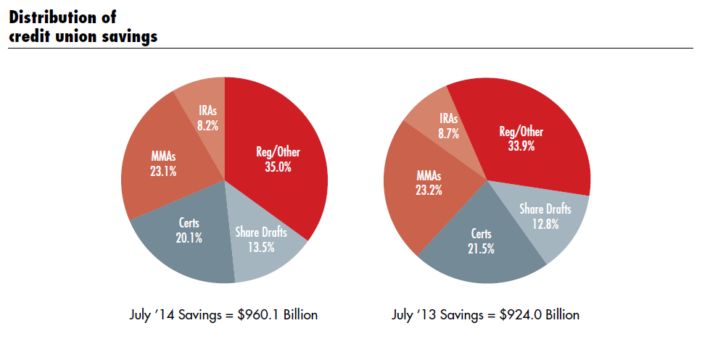
US credit union sector statistics
Notes:
Credit unions continue to see good performance with decent growth in savings from last summer to this summer.
We did a better than banks
- People noticed… membership increased.
- Small business lending increased in credit unions as banks were reducing lending to small businesses

Slide 5
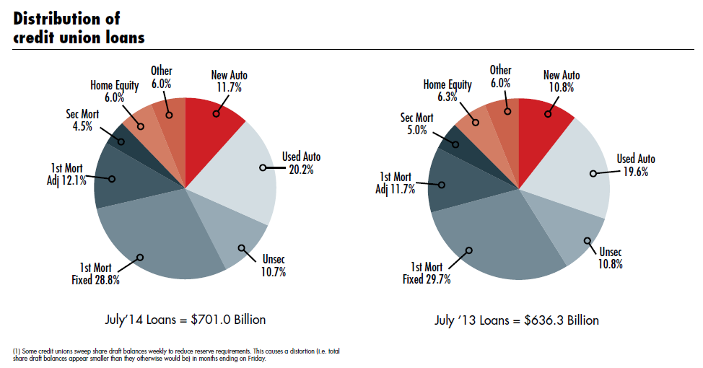
US credit union sector statistics
Notes:
Loan growth has also been good, signaling the confidence many members have in the future. The year to year growth in lending from $636 billion to $700 billion this past June.

Slide 6
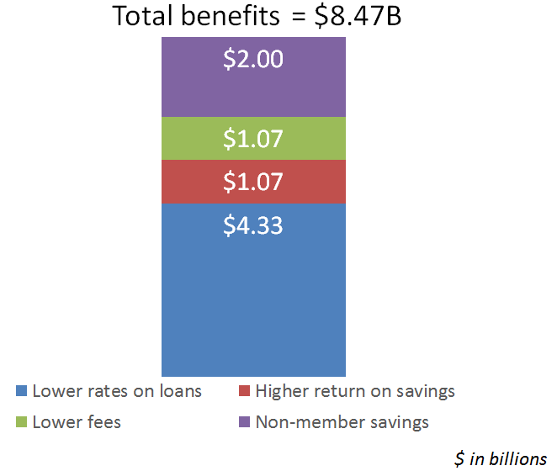
Credit unions save consumers money
Credit unions provide billions of $$ in financial benefits to consumers each year
(nearly $8.5 billion in 2013)
Notes:
A key part of the credit union difference we emphasize is the better deal members get by belonging to a credit union. Here we’re looking at the financial benefits the credit union system brings to the American economy.
$4.33 billion in savings through lower rates on loans
$1 billion in higher interest rates and earnings on savings
$1 billion in savings due to lower fees at credit union
And finally,
$2 billion in savings in general because of the competitive pressure on the fees and other expenses at the big banks due to credit unions.

Slide 7
Credit unions worldwide
101 Countries
56,000 Credit Unions
$1.3 Trillion in Savings
$1.1 Trillion in Loans
$1.7 Trillion in Assets
200 Million Members
Notes:
Here’s a quick look at the credit union movement internationally.
It’s growing nicely,
Credit unions in the U.S. are happy to serve as advisors, mentors to those interested in growing credit unions.
Next year, the World Council of Credit Unions meeting will be held in Denver, Colorado in conjunction with the Credit Union National Association’s annual conference.

Slide 8
Our shared vision for credit unions:
More Americans choose credit unions as their best financial partner
Notes:
In the United States, credit unions have made collaborative banking a successful way of life for millions, while offering first-rate member service and impressive savings.
But we have only 100 million memberships in a nation of over 300 million.
And of those members, fewer than half call their credit union their primary financial institution. We believe it's time for a new vision for the future of credit unions:
AMERICANS CHOOSE CREDIT UNIONS AS THEIR BEST FINANCIAL PARTNER
This is a vision based on our shared values: collaboration, a focus on members, community involvement and a dedication to financial well-being. Unite for Good.
CUNA launched a site for credit unions to focus our efforts on this important goal. It serves as a hub where people can come together, share stories and collaborate on the work involved in getting members to choose a credit union to be there primary financial partner.

Slide 9
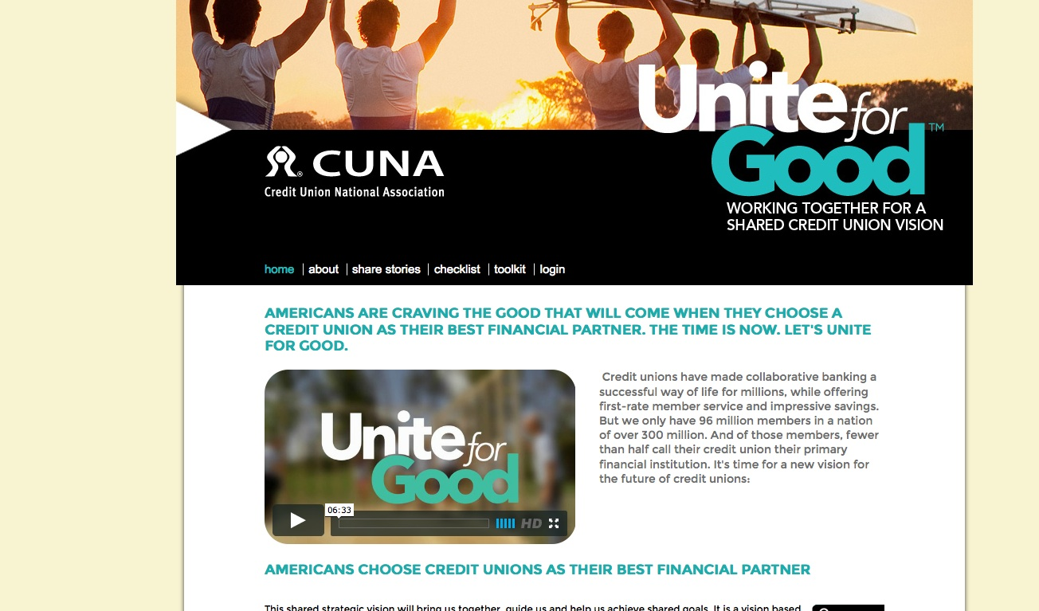
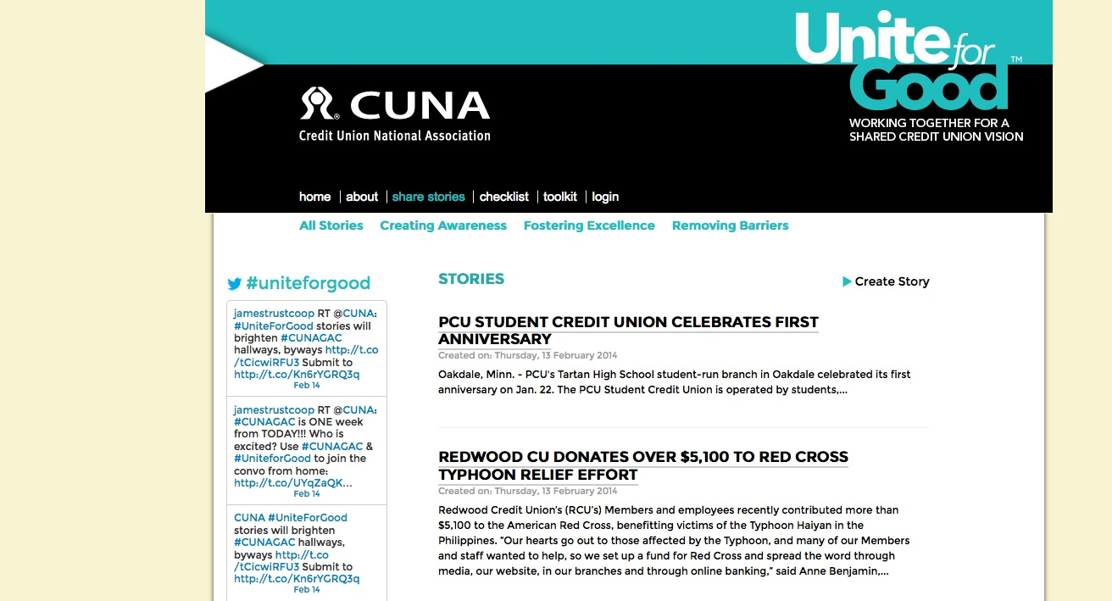
Serving our communities
Notes:
Our “Unite for Good” website – that is, uniteforgood.org -- includes a wealth of stories and examples about how credit unions are serving their communities. In fact, we’ve been collecting those stories from credit unions over the past year under the “share stories” tab on the website.
To date, we’ve collected more than 200 stories contributed by credit unions from across the country. These stories focus on all sort of activities undertaken by credit unions – from bake sales to long-term fundraising events.

Slide 10
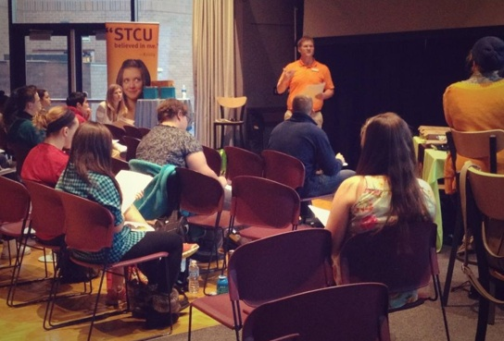
Serving our communities
Spokane Teachers Credit Union
Liberty Lake, WA
Notes:
At Spokane Teachers Credit Union in Liberty Lake, Washington (near the Washington/Idaho state line), the emphasis on been on financial education.
Founded by teachers, education is in the DNA of the credit union – and STCU remains deeply committed. The credit union deploys three community development officers – such as Keith Appleton here in a student financial briefing at a local university -- and taps experts from other areas of the credit union for emphasis. Community outreach has become a near-daily experience for STCU.
The results in 2013: STCU reached more than 6,300 community members with financial education, including 1,716 adults who attended 83 workshops, and 4,627 teens and pre-teens who attended 173 events.

Slide 11
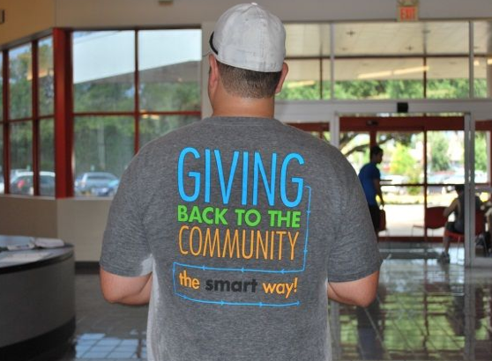
Serving our communities
Smart Financial Credit Union
Houston, TX
Notes:
Smart Financial Credit Union in Houston puts its back into efforts to support the community. Last year, the credit union created a public foundation, with the express purpose of “changing lives, improving communities and achieving dreams.”
Smart Financial Foundation donates time, money and other resources to not only individuals but also organizations that help raise credit union awareness.
As part of its community outreach program, Smart Financial Foundation partnered in Youth in Philanthropy – which provides opportunities for junior and senior high school students to learn the roles that volunteering and philanthropy play in building a better community. Through this partnership in 2013, the Smart Financial Foundation awarded several graduating high school students with scholarships.

Slide 12
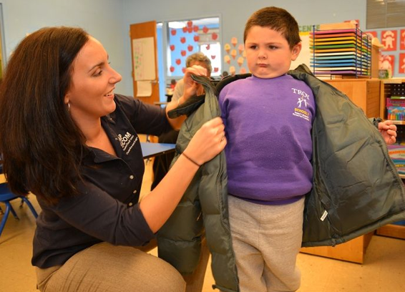
Serving our communities
Capital Communications
Federal Credit Union
Albany, NY
Notes:
Capital Communications Federal Credit Union in Albany, New York – CapCom as it is known locally – gave underprivileged kids in its community a warm embrace, with new coats for the winter.
CapCom partnered with a family-owned, local department store to boost its commitment to the annual Coats for Kids Program managed by the local Commission on Economic Opportunity. Credit union volunteers helped deliver 225 coats to kids at various local programs.
And, in the wake of federal funding cuts to Head Start Programs, CapCom covered the Commission’s budget shortfall so that 75 additional students could receive warm winter coats too.

Slide 13
Serving our communities
Valley Credit Union
Salem, OR
Notes:
Valley Credit Union in Salem, Oregon, says it may not be the biggest financial institution in its city – but the credit union knows it has a huge impact on the lives of the people who live and work in the mid-Willamette Valley in Oregon.
Early this year, the credit union sponsored two events to raise funds for victims of violent crime and to collect much-needed supplies for struggling, local families.
Valley Credit Union is a presenting sponsor of CrossWalk, which raises funds to help the local District Attorney’s victim assistance division provide a number of services. That includes direct victim services, advocacy for victims’ rights and promoting public awareness. The program also provides 24-hour, on-call response for victims of sexual assault and for the surviving loved ones of homicide victims.
And, in the “Family Building Blocks” program, the credit union helped collect more than 2,400 diapers and hundreds of other hygiene products — baby wipes, shampoo, soap and laundry detergent — for local children and their families struggling to make do in the local economy.

Slide 14
Serving our communities
Pacific Oaks Federal Credit Union
Camarillo, CA
Notes:
At Pacific Oaks Federal Credit Union in Camarillo, California, financial education is a top priority. In a diverse community that faces unique financial challenges, customizing community financial education outreach with productive resources has been critical to success.
The credit union has partnered with local area schools and developed educational programming designed to speak to students at specific age ranges, from middle school all the way to college.
By soliciting feedback from the students and educators, the credit union has customized materials and programs for each age range, making sure the financial education message resonates with specific groups.

Slide 15
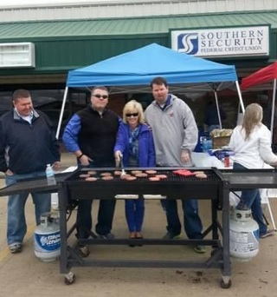
Serving our communities
Southern Security Federal Credit Union
Memphis, TN
Notes:
Southern Security Federal Credit Union in Memphis, Tennessee, actively “connects and re-connects” with its members, sponsor groups and the communities in which its members and sponsors live and work.
Through its “Connect, Create, Communicate and Continue” campaign, the credit union reached out to, visited with, and held expos and enrollments at its 500-plus sponsor companies, and held monthly “member appreciation days.”
Southern Security also backs its community through fundraisers for a local childrens’ hospital, holiday outreach for underprivileged children – and community cookouts, such as this one at its branch in Pontotoc, Mississippi.

Slide 16
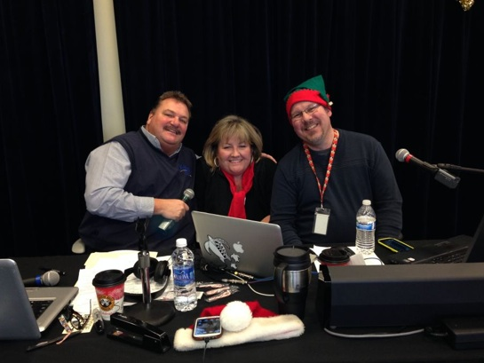
Serving our communities
Providence Federal Credit Union
Milwaukie, OR
Notes:
Providence Federal Credit Union of Milwaukie, Oregon, employs a “Community Impact” committee for generating fundraising ideas and developing ways to make a difference in the lives of its neighbors.
The committee found a variety of ways to support efforts of local fire fighters to help underprivileged kids, and to help raise funds for a local children’s hospital – including by sponsoring a phone bank during a radioathon to support the hospital.

Slide 17
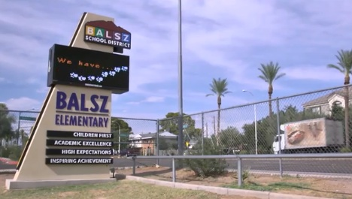
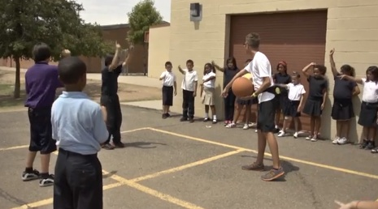
Serving our communities
Desert Schools Federal Credit Union
Phoenix, AZ
Notes:
“Community giving” is a core value at Desert Schools Federal Credit Union in Phoenix. The credit union partners with a Phoenix community that has long struggled with its economic challenges – where household incomes are well below the poverty level.
In particular, the credit union donates school supplies, provides grant funding, and teaches financial literacy education to students, teachers, and parents.
The credit union also helps fund an instructor for the “Playworks” program, which utilizes meaningful play and exercise to help children learn – and help them overcome behavioral problems during recess, which had been an emerging issue in the community’s school. Schools that implement Playworks games and activities into recess have experienced a decrease in bullying, an improvement in overall school climate, a reduction in disciplinary incidents, and more participation in academics.

Slide 18
Serving our communities
BrightStar Credit Union
Sunrise, FL
Notes:
Credit unions serve all of their members – and reach out to all of them as well, where they work or where they go to school.
BrightStar Credit Union, in the Fort Lauderdale area, sponsored a Black History Month program this month, featuring tributes to Dr. Martin Luther King, Nelson Mandela and Etta James.
The program, part of Taravella High School’s Black History Month Celebration, drew more than 700 students to the event – and 35 students performed or acted as stage crew. Performances featured high school students reading poetry, performing hip hop and ballet routines, comedy acts and songs.

Slide 19
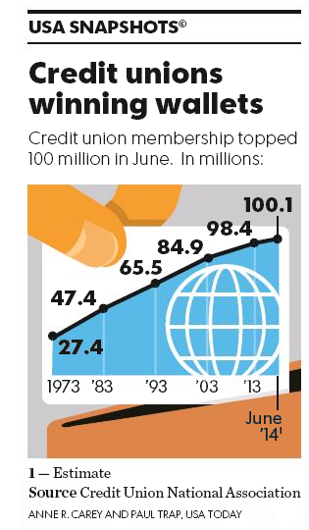
Our shared vision:
More Americans choose credit unions as their best financial partner
To get there, we are:
Removing barriers
Creating awareness
Fostering service excellence
Notes:
I share these stories with you to demonstrate how credit unions are reaching out to their communities – in a variety of ways.
You may have noticed the common element in each of the examples I’ve shared with you: The People. That is the great, shared resource of the credit union/ cooperative financial institution movement. Clearly, our people are committed to working with and helping our communities.
Each of these efforts I have shown here are going a long way toward helping us achieve the three “shared agenda” items of our system vision: Remove Barriers, Create Awareness and Foster Service Excellence.
To realize this vision, CUNA, leagues, and credit unions are all focused on three goals:
Remove barriers by actively participating in credit union grassroots activities and the political process
Create awareness by expanding your credit union's outreach and image in the community and sharing these stories for everyone to hear
Foster service excellence by offering a complete set of forward-looking and constantly improving financial services to members of all backgrounds and life stages

Slide 20
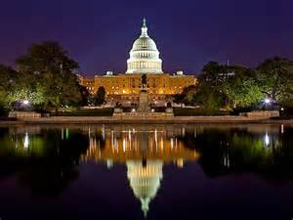
Removing Barriers
Fighting for regulatory relief
On Capitol Hill
At government agencies
Making our case publicly
Notes:
The financial crisis in America left many with a deep distrust of institutions, particularly large banks and Wall Street.
The led to the enactment of several new laws, intended to address the misdeeds on Wall Street, but credit unions and other small institutions got swept into the restrictions in some cases.
Credit unions have been working to untangle and simplify the regulatory burden we currently face.
On Capitol Hill that means fighting to have the credit union business model (consumer ownership) recognized as significantly different than the investor-owned, Wall Street model. One would think that would be easy, but with all the gridlock in Washington and high turnover in Congress it isn’t.
At the agencies, the work is the same – we try to help them write the rules implementing new laws in a way that recognizes how credit unions are different.
A key component of this effort is making our case publicly through the media and grassroots action for what we need public officials to do.

Slide 21
Regulatory relief on Capitol Hill:
Incremental steps to achieve goals
In 2013/2014
Active with 39 bills, testified ten times
Seven bills passed House, pushing for Senate votes
24 bills passed House committee, pushing for votes by full House
“Don’t Tax” campaign defeated effort to revoke not-for-profit status of credit unions
Notes:
The gridlock around public policy in Washington means that very little is getting done and the hope that a broad, comprehensive bill to achieve regulatory relief for credit unions would have no chance of making it.
CUNA is working on a strategy using targeted bills on individual issues to chip away at the relief we need.
In this Congressional 2 year term, credit unions have been active with 39 bills and testified before various committees ten times.
7 bills passed the House and are at the Senate awaiting action.
24 bills passed out of committee and are waiting for votes in the full House of Representatives.
The Don’t Tax My Credit Union campaign was a successful grassroots effort to beat back attempts by the big-banks to eliminate the not-for-profit tax status of credit unions.

Slide 22
Regulatory relief at agencies:
Work with regulators writing rules to implement laws
Wrote 77 comment letters over the last 18 months
Continue pushing, making our case wherever necessary
Notes:
At the agencies, CUs are active in working to influence how the rules are written to implement laws Congress passes.
Many, in response to financial crisis, don’t fit credit unions.
The National Credit Union Administration is the federal regulator for CUs.
The CFPB, a new government agency formed in the wake of the financial crisis, has been proposing rules that will make it more difficult for CUs to serve the best interests of members.

Slide 23
Regulatory relief at the state capitals:
Monitoring 2,000 state bills this year affecting state and many federal credit unions
Representing credit unions at conferences of state legislators-
Key relationships – 50% of those in Congress previously served in their state legislatures
Notes:
Credit unions are also active at the state-level.
Credit union leagues (our state trade associations) are active with state legislatures regarding state charters for CUs and other rules governing credit unions.
Conferences of these state elected officials offer the credit union movement a good way to educate them about the credit union difference and our priorities.

Slide 24
A Smarter Choice
Helps consumers find a credit union that’s right for them.
Unified effort to educate and inform people.
Notes:
A Smarter Choice is a unified credit union effort to help people find a credit union that is right for them.
It supports the shared vision that more people will choose a credit union - and make that credit union their primary financial partner.
There are resources on the site that explain credit unions, a place to find credit unions, a blog to read recent news, and financial education.

Slide 25
A Smarter Choice
Locator Tool:
Helps consumers find a credit union that’s right for them
Notes:
Here is a look at the locator tool. The database is updated regularly to include new credit union locations, CU mergers and other information a consumer will need to make an informed choice.

Slide 26
A Smarter Choice
Helps create awareness and offers consumers a way to learn how credit unions are different than banks.
Notes:
This page explains the differences between a CU and a bank. More information is on the page than you can see here – it includes vivid graphics that make it easy for people to understand the advantages of belonging to a credit union.

Slide 27
A Smarter Choice
The blog has regular updates about the advantages of credit union service.
Notes:
And here’s the blog on the site. It’s updated regularly and includes Twitter and other social media feeds important to the effort of helping people understand credit unions so they can make an informed choice.

Slide 28
A Smarter Choice
Content helps people learn about managing their finances and other components building a secure financial future.
Notes:
And here’s the page with financial education information. It’s nice set of basic dos and don’ts around financial planning and managing money.
Financial education is one of the top priorities for credit unions. One key mission of ours is helping our members build a secure financial future.
Individual credit unions promote financial literacy in their communities. At my credit union we have branch offices in 2 of the local high schools and one elementary school. We teach children how to save and manage their money. We work with the teachers and provide financial information and lessons for the students.
We also offer lunch and learn sessions in the afternoon and evening for adults to share information on financial literacy. Topic include: How to qualify for a home loan, how to get the best deal on a vehicle purchase, planning for retirement, investing and tax advice.

Slide 29
Celebrating 100 million credit union memberships helps raise awareness
Builds on the legacy begun 80 years ago
Enactment of the Federal Credit Union Act
Creation of Credit Union National Association
Advances our shared vision
Americans choose credit unions as their best financial partner
Notes:
This summer credit union membership in the United States surpassed 100 million.
An achievement worth celebrating.
It builds on the anniversary of the enactment of the Federal Credit Union Act which gave credit unions the ability to get a federal charter – avoiding the often complex state charter process.
And the 80th anniversary of the Credit Union National Association.
A key component of the campaign was our shared vision.

Slide 30
Raising Awareness
Emphasize the credit union difference:
Elected officials
Regulators
Media, reporters
Consumers, particularly younger generation
Notes:
A key priority in the shared vision that more Americans will choose a credit union is raising awareness among our key stakeholders.
And it is an ongoing, never-ending effort because there are always new elected officials, regulators, reporters to educate – but also there are always new consumers to talk with to join our movement.
The ‘winning wallets’ graphic was something we were able to place in USA Today a large national newspaper in the U.S. – delivering a clean, simple message about the growth and strength of the credit union movement.

Slide 31
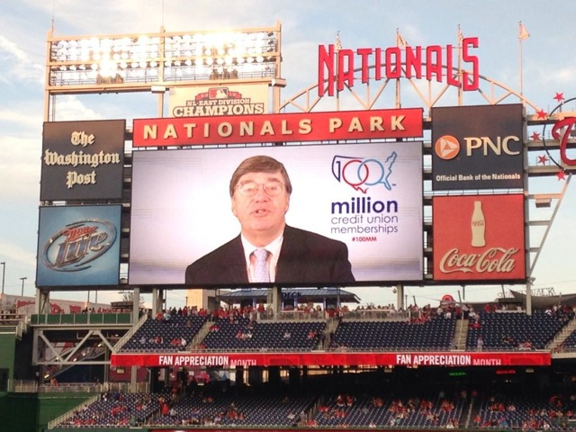
100 million credit union memberships
Working with leagues and CUs
Media coverage raised awareness
CUNA events in Washington, D.C., including Nationals baseball
Social media outreach for younger audience awareness
Campaign to add a ‘selfie’ to the website
Notes:
To roll-out the campaign we worked closely with credit unions and the leagues to coordinate messages and activity.
We had a strong earned media push – garnering good stories in the Wall Street Journal, New York Times, national radio shows, regional and local press among others.
CUNA events in Washington helped raise awareness among key decision makers and the media – including a night at the Nationals baseball game.
Social media outreach, Twitter chats all helped spread the word in these channels and with younger consumers. On Twitter – search #100mm to see recent activity.
Our campaign website – americascreditunions.org – gave many the chances to take a selfie and submit it to the website.
Here’s how it looks…. (next slide)

Slide 32
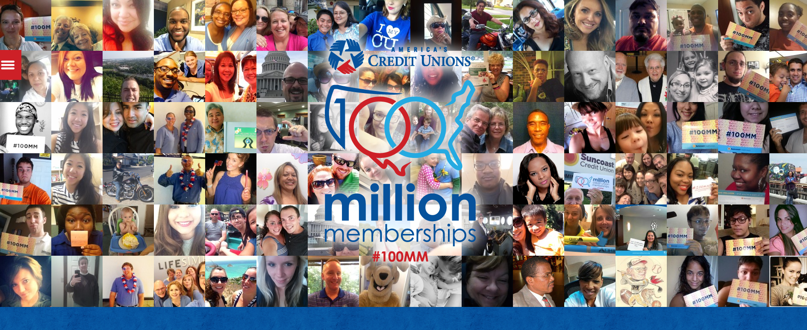
www.americascreditunions.org
Notes:
As part of the 100 million memberships celebration, CUNA launched the website – americascreditunions.org – to anchor the activity and give consumers a place to participate and learn more about the movement.
Each picture on the site came from credit union members who submitted a photo or had theirs taken at a credit union event.
Thousands of pictures were submitted and are part of the ‘moving’ image that scrolls across the screen.
Also on the web site are resources and links to state specific information about credit unions and local activity celebrating the 100 million memberships milestone.

Slide 33
CUNA political action
On pace to invest almost $5.5 million this cycle
Almost $4 million through CULAC
About $1.5 million through National Advocacy Fund
CULAC on pace to set another record
Notes:
As the election season heats up in the U.S. – work to support credit union friends running for office is moving into high-gear.
CUNA and credit unions are active politically – it’s necessary these days to be engaged in that arena.
The political action fund run by our trade association will put about $5.5 million to work on behalf of candidates over the 2013/2014 election cycle.
And it will be another record setting year. Donations to the action fund come from tens of thousands of credit union people and tend to be smaller individual amounts.
Yet another sign of the power of cooperation.

Slide 34
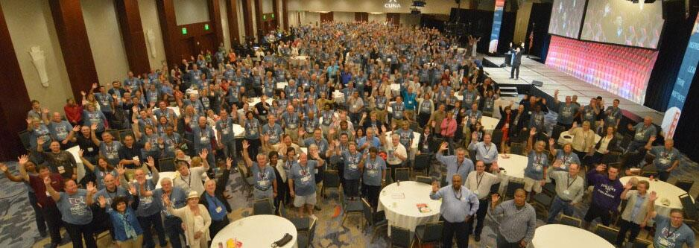
Credit Unions working together through CUNA
Annual conference helps education and peer to peer learning; next year with World Council
CUNA Management School graduates 58th class for professional development
Online learning growth, ease of access
CUNA Councils surpass 6,000 memberships, professions within the network
Notes:
CUNA plays an important role in the life of credit unions and employees and volunteer directors.
The association holds conferences and training events where people can come together to learn from each other.
Online learning is also growing fast as people with busy jobs and families find it difficult to travel. The online learning system CUNA built offers people a chance to stay informed and learn about innovation and best practices.
The CUNA councils are group of staff organized around common professions and play a vital role in the work of the association.

Slide 35
Credit Unions working together through service organizations
CUSOs - businesses formed by a credit union to offer services to other credit unions
Avenue for innovation and efficiency, economy of scale
Reduces costs within the traditional credit union
Allows credit unions to access services that may not be affordable individually
Notes:
Credit union service organizations - CUSOs - are formed for all sorts of reasons. They can provide avenues for innovation and creativity that would not typically occur within the confines of a credit union. They can provide a revenue stream for credit unions that would not be available within the confines of a credit union. They can reduce service costs incurred within the traditional credit union. Some may do all three. Generally, these outcomes are the result of collaboration and the cooperative spirit that is inherent in the credit union industry.

Slide 36
Credit unions delivering service excellence to members and communities
Financial Education
Helping the “Unbanked”
ATM networks, technology innovation
Fees better than banks
Higher returns on savings
Lower interest rates on loans
Notes:
Credit unions do a good job assisting members to become better- educated consumers of financial services. Whether in schools or elsewhere, CUs have a long-established track record of doing the right thing to keep consumers informed about financial education.
They bring people who do not have a relationship with a financial institution into the movement.
Additionally, CUNA is partnering with the National Endowment for Financial Education, a not-for-profit foundation, to expand financial education among high school students. A national study shows that just ten hours of personal finance education can positively affect students' spending and savings habits for a lifetime.

Slide 37
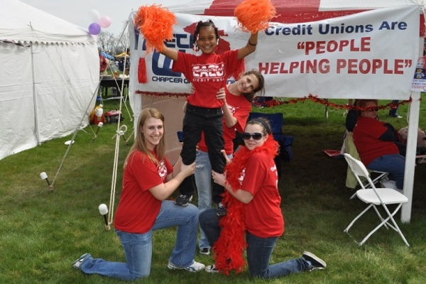
Community Development
Low-income credit unions (LICUs)
Products designed to assist low-income individuals and families
Financial literacy
Youth programs
Communicating Arts Credit Union in Detroit, MI
Notes:
Social Purpose: People Helping People. Credit unions exist to help people. Our goal is to serve all of our members well, including those of modest means - every member counts. Our members are fiercely loyal for this reason. They know their credit union will be there for them in bad times, as well as good. The same people-first philosophy causes credit unions and our employees to get involved in community charitable activities and worthwhile causes.
While the credit union movement has grown and credit unions have evolved, they haven’t forgotten their roots and why they were established – to help people get away from money lenders and have access to affordable credit and savings. To this day, they continue to serve the unbanked and underserved and promote financial inclusion.
Today, 1,993 or nearly 30% of all US credit unions are LICUs.
To reach low-income, credit unions often:
- Design products to assist low-income individuals and families (first-time homebuyer, ‘no minimum balance’ checking, no-fee checking, fewer/lower fees generally)
- Provide Financial education, financial literacy and financial counseling services
- Develop Youth programs (to help young people learn to manage their money)

Slide 38
International Credit Union Day – Oct. 16
Credit unions in the United States participate
Annual celebration since 1948
Unites the worldwide credit union movement
Notes:
International Credit Union Day has been celebrated annually since 1948.
It is a good tie-in to the annual October observation of Cooperative Month.
Many will hold celebrations to highlight the difference credit union make in their communities.
More than 200 million worldwide enjoy the benefits of credit unions – more can with greater awareness.
That’s what the credit union day is meant to do. Build awareness and help people find a credit union that is right for them.

Slide 39
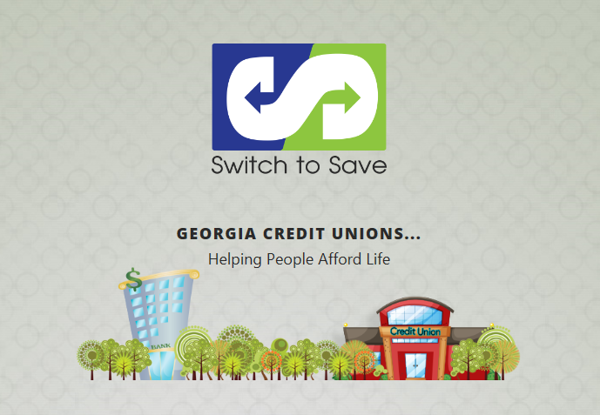
International Credit Union Day
Notes:
In Georgia, credit unions are promoting a Switch to Save campaign that helps consumers identify savings on loans. A member or potential member can bring in two months of statements from another financial institution to determine if switching their loan to the credit union will save them money, according to the Georgia Credit Union Affiliates (GCUA).

Slide 40
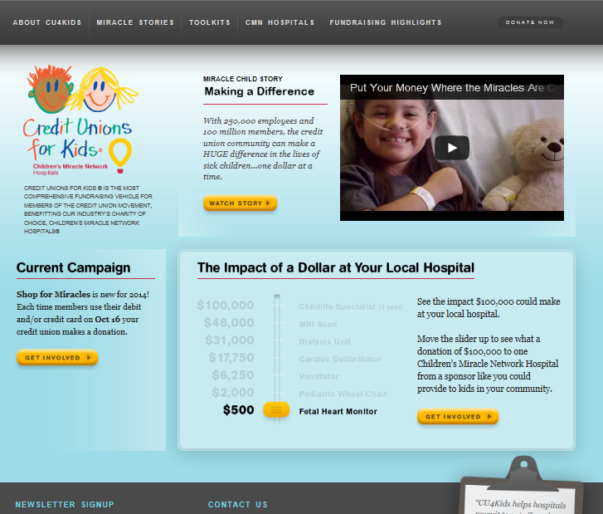
International Credit Union Day
Notes:
Credit Unions for Kids will hold Shop for Miracles, a one-day fundraising program to support local Children's Miracle Network Hospitals.
Every time a member of a participating credit union swipes his or her credit union-issued credit or debit card, the credit union will donate 25 cents, or another predetermined amount, to a local Children's Miracle Network Hospital. Shop for Miracles is sponsored by the Credit Union National Association, the World Council of Credit Unions and Credit Unions for Kids. CO-OP Financial Services also will tie its Miracle Match program to Shop for Miracles, matching funds dollar-for-dollar up to $10,000 with certain participating credit unions.

Slide 41
The cooperative business model serves credit unions well
Voluntary and open membership
Democratic control
Economic Participation
Autonomy and independence
Education, training, information
Cooperation among cooperatives
Concern for community
Notes:
Credit unions are democratically owned and controlled institutions that take pride in their "people helping people" philosophy.
Credit union boards of directors are elected by members; each member has an equal vote, regardless of how much he or she has on deposit.
Only members may serve as directors, and directors generally serve without remuneration.
Volunteers are an important credit union resource. Presently, approximately 86,000 Americans volunteer for their credit unions, serving as board members, committee members or providing other assistance.
Credit unions have no outside stockholders, so after reserves are set aside, earnings are returned to members in the form of dividends on savings, lower loan rates and fees, or additional services.

Slide 42
Members respond well to credit unions
Our business model puts them first
Measures of trust and satisfaction are excellent:
American Customer Satisfaction Index (ACSI)
Credit unions - 85
Big banks in general -78
Chicago Booth/Kellogg School Financial Trust Index
60% say credit unions are trustworthy
30% say they trust big, national banks
Notes:
Credit union people are dedicated to a cause and a movement that makes a difference in people’s lives. The improve the quality of life of their members and communities.
The focus is recognized by people. Here’s some recent data to support the point.
The American Customer Satisfaction Index (well respected measure of consumer confidence) reports that credit unions score an 85 on the index while big banks score a 78. A significant difference.
Additionally, the Chicago Booth Kellogg financial trust index reports that 60% of people say credit unions are trustworthy, and by comparison only 30% say big banks are trustworthy.

Slide 43
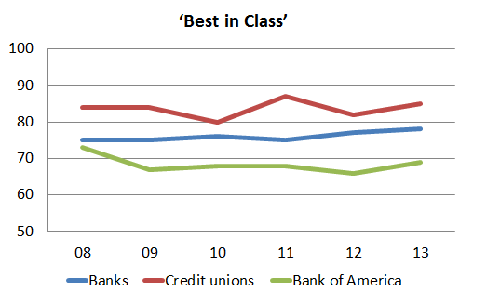
Demand Driven Approach
Consumers like us
Highest point ever on ACS Index
But banks are posting gains
Consumers like us
Convenience
Good prices
Choice: variety of savings and loan products
Financial education
Notes:
Let’s take another look at how credit unions do with consumers.
They like us for the convenience, good prices, choices and options, and education that we offer.
Great news!

Slide 44
So it’s full speed ahead for credit unions
We will always work to be:
An effective advocate for our members
A respected voice on the issues
Dedicated to the unity of the movement
Notes:
Thank you very much for the opportunity to be with you today. I would like to personally thank Nomadello – you are so lucky to have someone like her working on behalf of credit unions. She is truly a remarkable woman and a wonderful resource for all of you!
I have enjoyed my time here and getting to know your amazing country.
For credit unions – I think we can agree that the opportunities ahead are boundless.
Together we can;
Work to be effective advocates for our members –
A respected voice on the issues that matter to credit unions
And dedicated to the unity of our movement – because together we can accomplish more.

Slide 45
Thank you! Questions?
Notes:
Do you have any questions for me?

